Slide 1
Activation. Knowledge, skills and confidence to manage one’s own health and wellbeing
Alf Collins
Clinical Lead for Person and Community Centred Care
NHS England
Health Coaching Cambridge. 19th September 2016

Slide 2
The Passive Patient
Healthcare can be profoundly disempowering
But most patients want to be treated as active participants – as co-producers of health.

Slide 3
Co-producing health
Working in partnership
Supporting self care/ self management
Shared decision making
Care planning

Slide 4
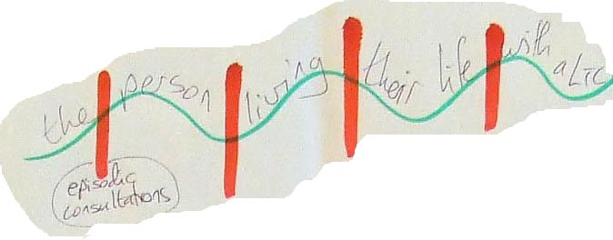
For people living with LTCs, usual care is self care
Hours with NHS / social care professional = 5-10 in a year
Self care/ self management
= 8750-55 in a year
Notes:
This is a key diagram (always has high face validity for patients and everyone else in the audience - helps them really see what the issues of living with a LTC are really about). It
Demonstrates the need visually from the person’ point of view
Identifies the problems with the current approach
Provides a visual framework to hang the Delivery System on. The DS addresses all the aspects across the ‘whole System’
NB Drawn by people with LTCs on a paper table cloth at a World Café workshop.
Points to note:
People with LTCs are self managing all the time (8757 hours) – it is not something that can be ‘given to them’ or ‘allowed’ by the NHS
The contacts with NHS usually appear regularly – uncoordinated with the ups and downs of everyday life
Surveys show that less than half the time allotted to the orange bars is devoted to discussing living with the condition or self management along the green wavy line.

Slide 5
Patients’ Goals may be Different from Clinicians’ Goals
To better manage my pain relief so I don’t wake up at night
To stay in my own home as long as possible
To stop taking anti-depressants because I don’t like the side-effects
To learn how to cook healthy meals that the whole family will enjoy
To have the same person caring for me from 9am to 3pm so my parents can go to work
To receive end-of-life care at the hospice close to where my sister lives
Source: Coalition for Collaborative Care. Personalised care and support planning handbook. NHS England 2015

Slide 6
Health
Managing my health conditions
Wellbeing
Managing the impact of my health conditions on my psychosocial functioning

Slide 7
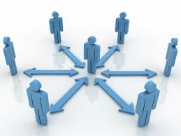
So…
The system should work in partnership with people with LTCs in order to support them to develop the knowledge, skills and confidence to manage their own health and wellbeing

Slide 8
Patient Activation Measure
Unidimensional (ie measures a single concept)
Developmental (ie appropriate interventions can support people to progress on a journey of activation)
Knowledge, skills and confidence to self manage
13 items, 4 levels
Score out of 100

Slide 10
PAM Scale
Source: J.Hibbard, University of Oregon

Slide 11
A developmental scale

Slide 12
35-40% of population have low or no confidence to manage their health
25-30% of population
10-15% of population
Notes:
7% of the population are at level 1 activation- they tend to enjoy a worse quality of life and have worse outcomes than people at level 4 activation

Slide 13
People at low levels of activation tend to:
Feel overwhelmed with the task of managing their health
Have low confidence in their ability to have a positive impact on their health
Not understand their role in care processes
Have limited problem solving skills
Have had a great deal of experience with failure in trying to manage, and have become passive with regard to their health
Say they would rather not think about their health

Slide 14
People at higher levels of activation tend to:
‘Be engaged’
Come prepared
Ask questions
Make decisions
Have less unmet needs (nb inequalities)
Have improved clinical outcomes (including mental health)
Enjoy an improved quality of life
Use less healthcare resource
Feel satisfied at work
Why Does Patient Activation Matter? An Examination of the Relationships Between Patient Activation and Health-Related Outcomes. Jessica Greene and Judith H. Hibbard Journal of General Internal Medicine, published online Nov. 30, 2011

Slide 15
Self care behaviours and activation 1
USA National sample 2008

Slide 16
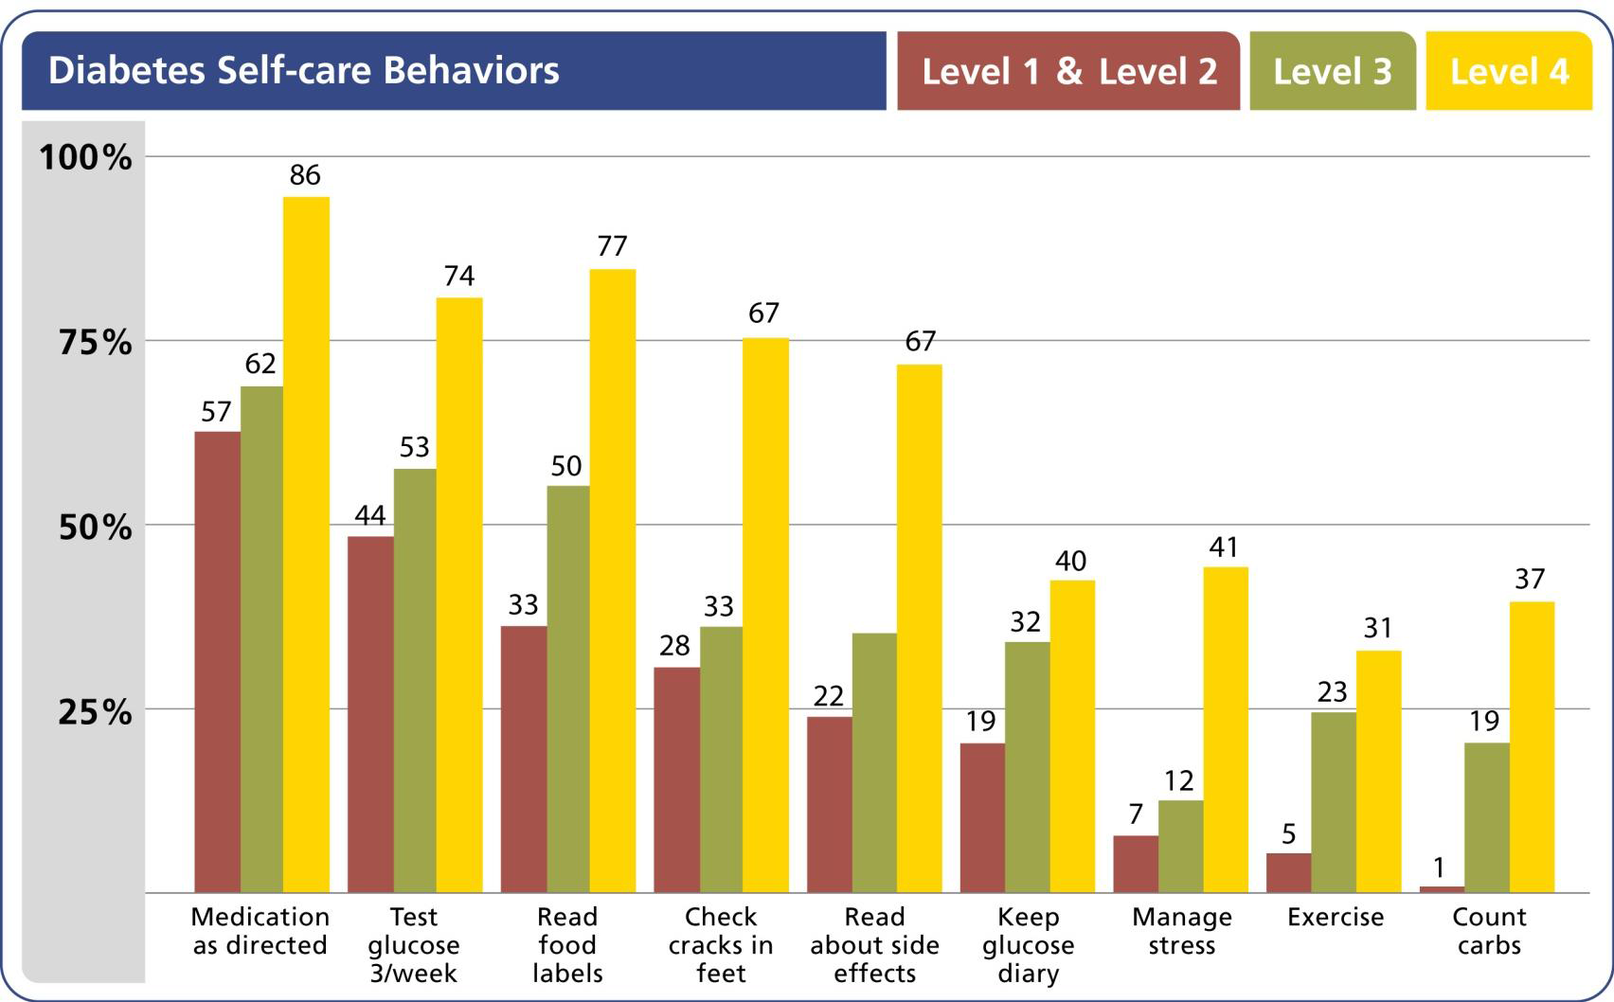
Self care behaviours and activation 2

Slide 17
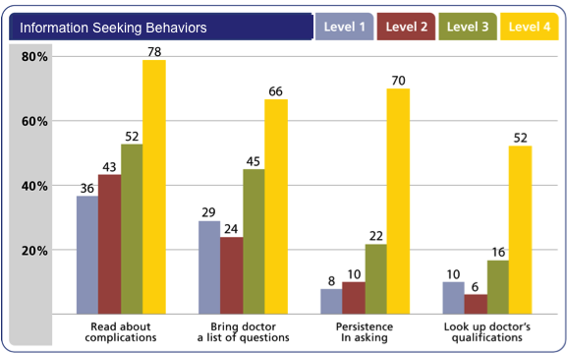
Encounters with clinicians and activation

Slide 18
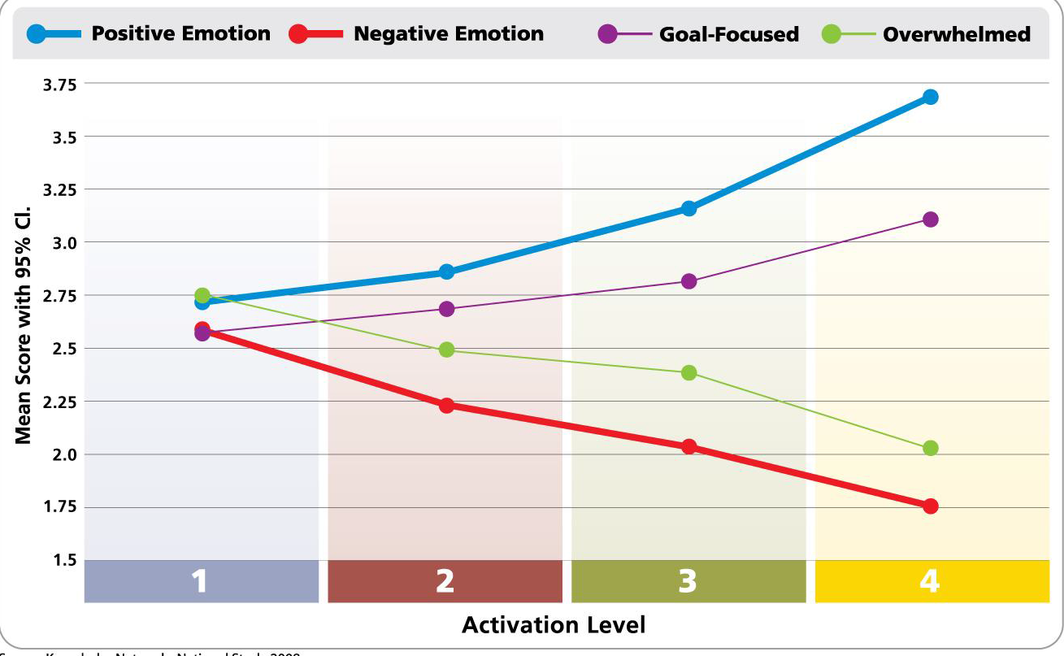
Emotional health and activation
US Knowledge Networks 2008

Slide 19
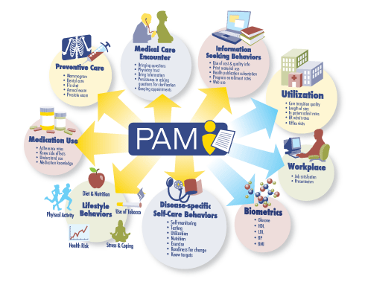

Slide 20
Patients can be supported on a ‘journey of activation’ by offering tailored interventions: 1:1 or group coaching. (nb Peer and community support)
Thus tailored interventions improve all other ‘downstream’ indicators

Slide 21
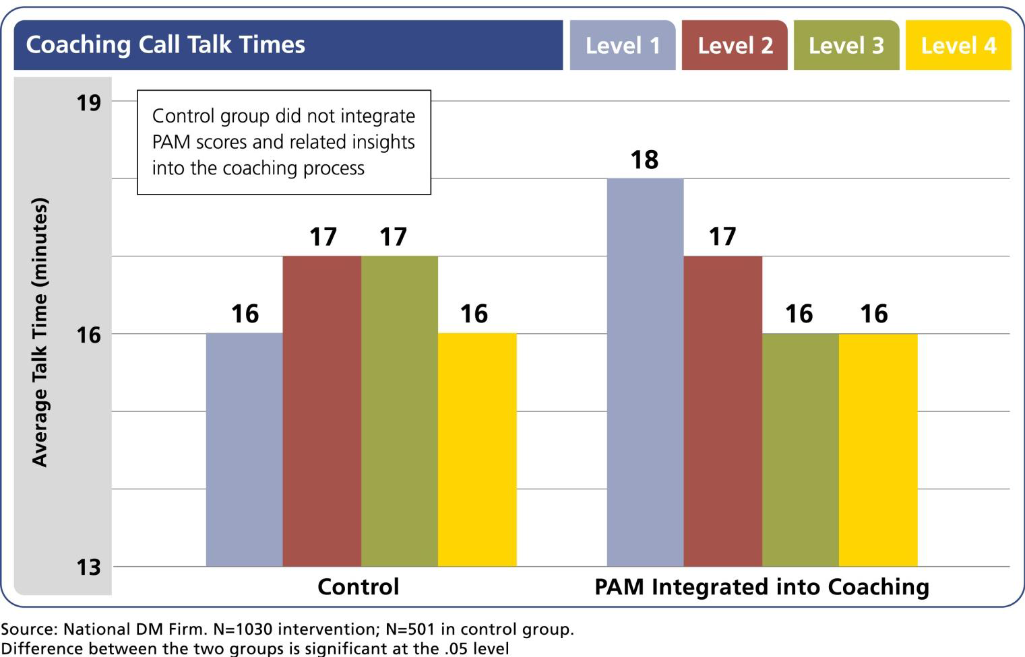
Tailored health coaching

Slide 22
People at lowest levels of activation gain the most from tailored interventions
http://www.population-health.manchester.ac.uk/primarycare/npcrdc-archive/archive/ProjectDetail.cfm/ID/117.htm
An evaluation of a self management programme for patients with LTCs. Turner A et al. Patient Education and Counseling 10/2014; 98(2). DOI:10.1016/j.pec.2014.08.022

Slide 23
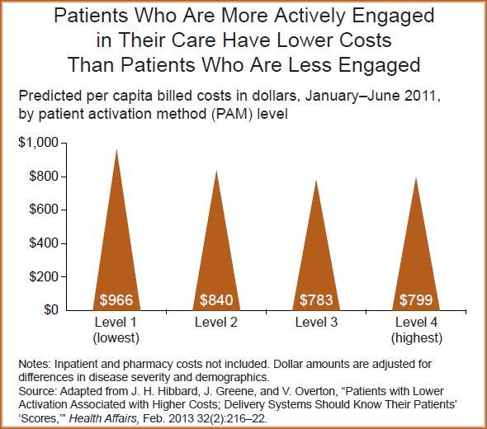
People at activation level 4 cost 31% less than people at level 1

Slide 24
Activation and utility across the system
Segmentation
Tailored coaching
Programme assessment
Predictive modelling
Target resources
Use resources more effectively
Start where people are
Personalise support
Quality assure interventions
Improve quality of interventions
More sophisticated understanding of drivers of risk

Slide 25
Questions and challenges remain
Concept or measure or both?
English translation
Activation as an outcome
Social model of health
The licencing issue…..

Slide 26
New Horizons
Empowering patients and communities (chapter 2 5YFV)
‘we will do more to support people to manage their own health –staying healthy, making informed choices of treatment, managing conditions and avoiding complications.’
2 million PAM licences now being used across system, including in the PACs and MCP Vanguards

Slide 27
http://www.kingsfund.org.uk/publications/supporting-people-manage-their-health
Alf Collins
September 19th 2016

